Slide 1
VIDHYADEEP INSTITUTE OF MANAGEMENT AND TECHNOLOGY
Prepared By:
130940119063
130940119064
130940119065
Guided By :Shyam D Patel

Slide 2
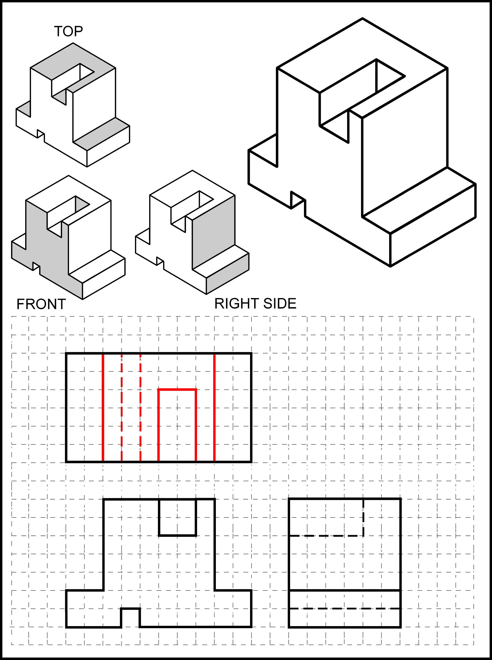

Slide 3
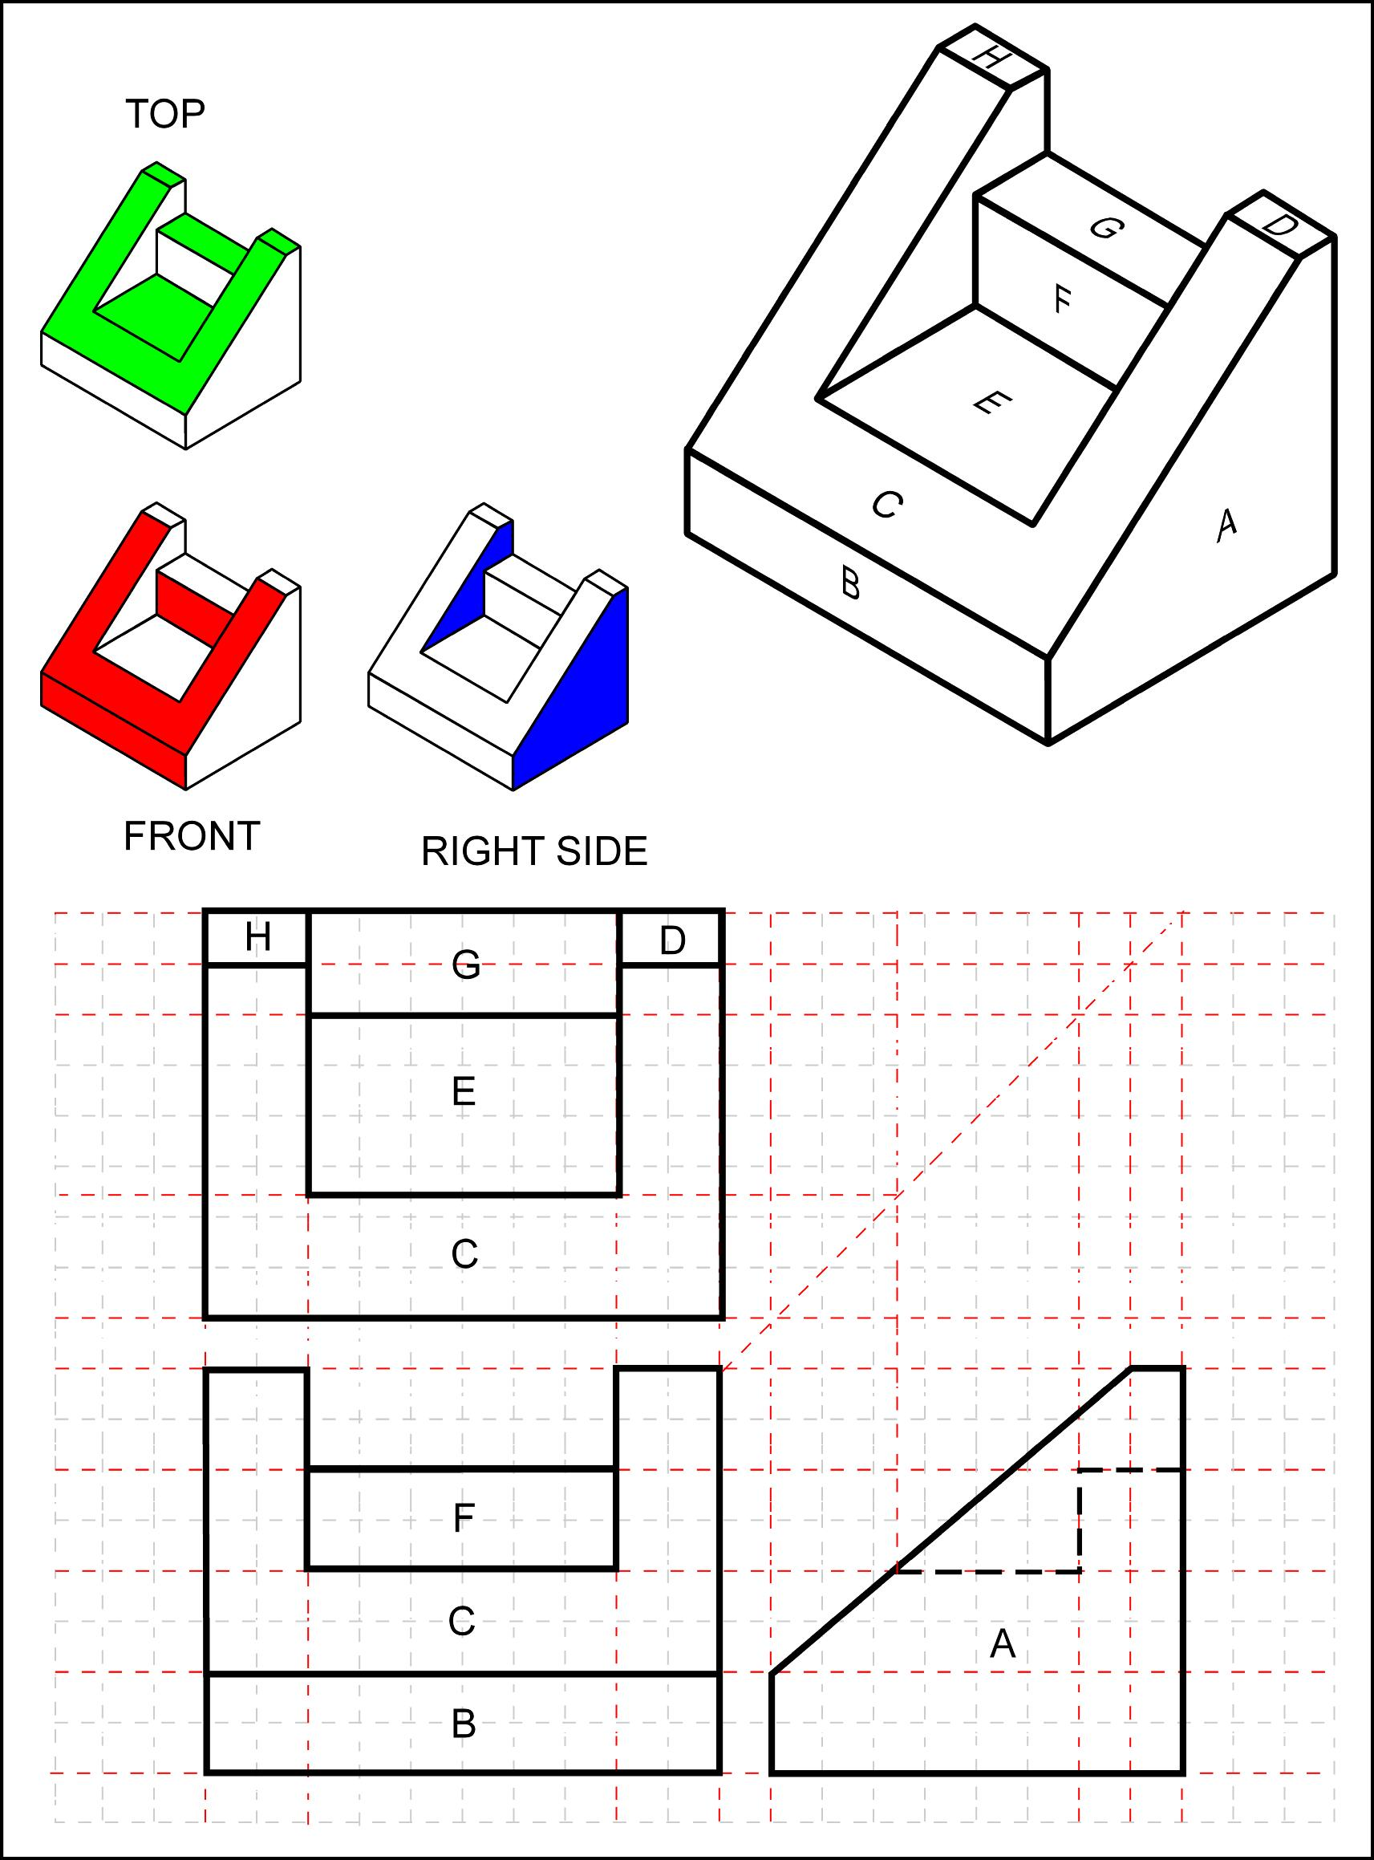

Slide 4
